Slide 1
Smart Security System
Adam Corbin, Stincii Dumerjean, Malia Kency, Jared Peterson
Group 5
CEN 5035 - Fall 2019

Slide 2
Overview
Purpose
Roles
System Components
Inputs
Outputs
Services
Demo

Slide 3
Purpose
The Smart Security System is designed for the modern always on the go user
The system guards their home and valuables while they are off on business or out on the town for fun
Google Calendar integration allows the system to automatically arm and disarm based on the users schedule
Messaging allows the user to quickly get notifications should trouble occur
Users can easily manage their system from any where with its web Interface

Slide 4
Roles
Adam Corbin - Project Owner – Hardware setup and API to Hardware
Stincii Dumerjean - Individual Contributor - Notifications
Malia Kency - Individual Contributor – UI Lead
Jared Peterson - Scrum Master – System integrator

Slide 5
System Components
Main system process handles state changes, threads, and sub-processes
Basic security detection methods with PIR sensor
Intelligent scheduling linked up to Google Calendar
Arm/Disarm using hardware keypad & web user interface
Notifications
Live stream
Watson Graphs
Automated & remote testing

Slide 6
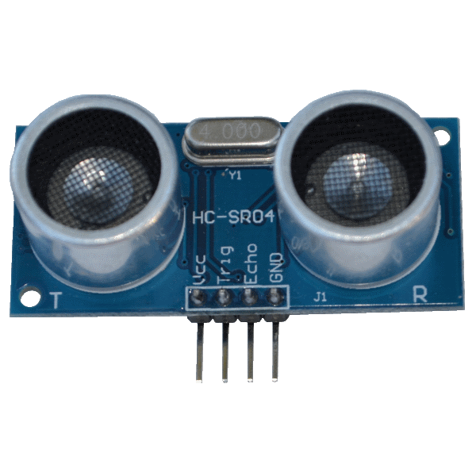
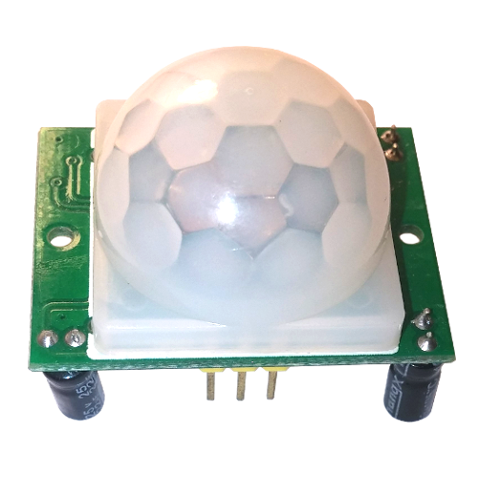
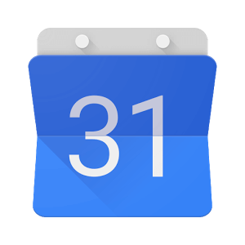
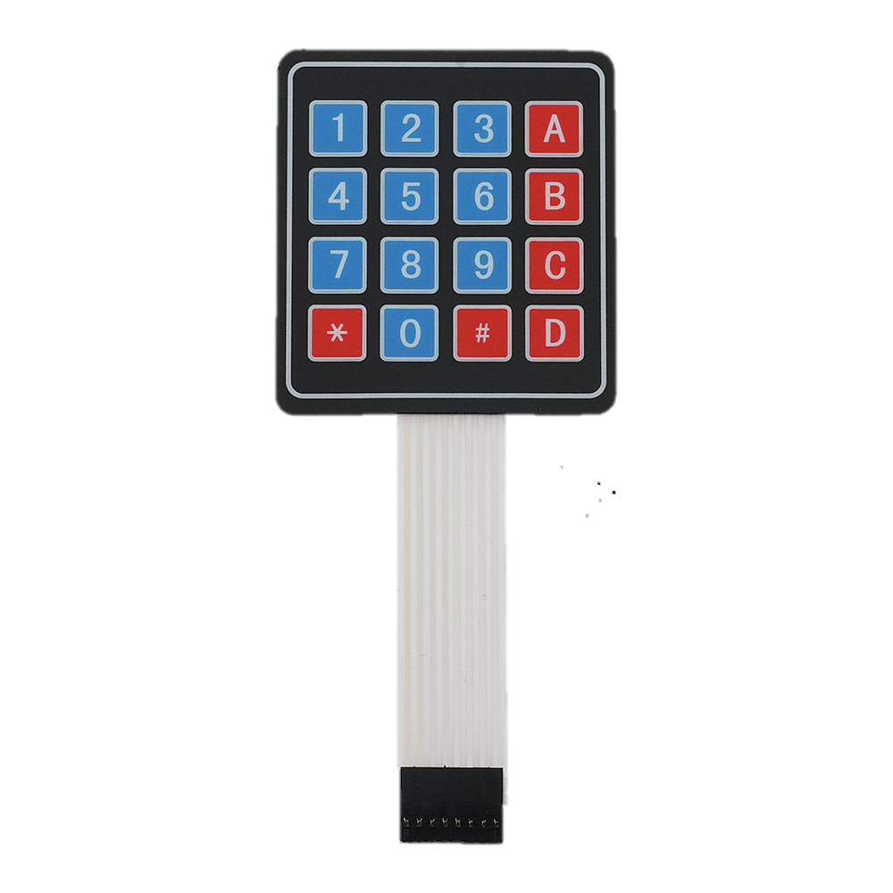
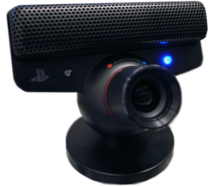
Inputs
HC-SR501 PIR(passive infrared) Motion Sensor
4x4 Matrix membrane switch
Google Calendar
PS3 Eye camera video
HC-RS04 Ultrasonic distance sensor

Slide 7
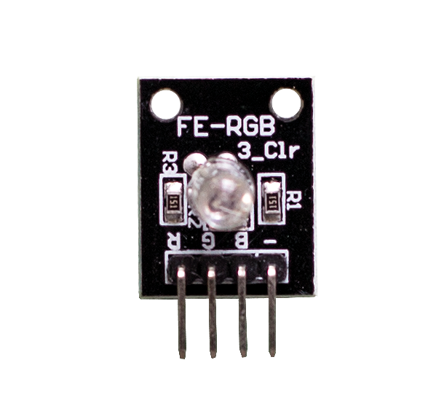
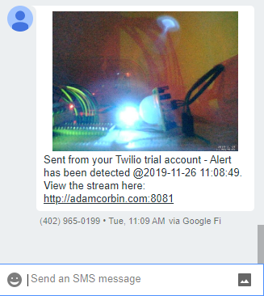
outputs
RGB LED Module
Web user interface
MMS Notifications

Slide 8
services
Watson Graphs
Motion project library
Flask for UI
Twilio API for notifications
Google Calendar API

Slide 9
Demo – test scenarios
Keypad wrong code
Keypad enable – show led flashing
Trigger alarm
View MMS
View live stream
Disarm system
View UI to show status and test arming & disarming
View Watson graphs
Automated and remote testing

